Slide 1


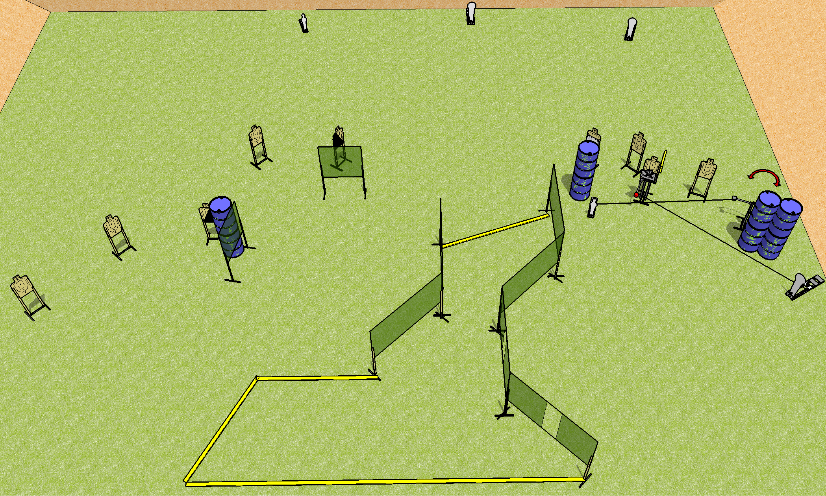
 | Dothan Gun Club – USPSA Match Muddled Course Designer : Drew Coleman Bay: 2
Round Count 25 rounds 10 USPSA 3 colt poppers, 2 minis
Equipment List 16 wall feet Swinger + max trap + activators 1 left + right diag 10 targets (8 + 2NS) 30 feet from upper right colt popper to shooting area. 26 feet from activator steel to ports.

Slide 2
Muddled
Written Stage Briefing
Scoring: Comstock Rounds: 25
Targets: 10 USPSA, 5 steel
Handgun start position: anywhere inside the shooting area, wrists below belt. Handgun is loaded and holstered.
PCC start position: anywhere inside the shooting area, stock on belt. Loaded carbine is held with both hands, safety on.
Stage Procedure: on the audible start signal, engage targets as they become available from within the shooting area.
The max trap is activated by P5 and remains visible at rest. The swinger is activated by P4 and remains visible at rest.

